Slide 1
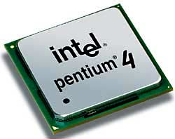
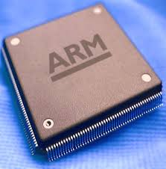
Microprocessors & Computer Architecture
UE18CS253
UNIT– 1
Interrupts & Interrupt Handling Mechanism
Credits:
MPCA Team
SESSION JAN-MAY 2020
1
Notes:
1

Slide 2



What is Interrupt/Exception?
Main ()
{
:
Doing something
(e.g.
browsing)
:
} ring
Phone rings
Can happen anytime
Depends on types of interrupts
_isr() // Interrupt service routine
{
some tasks (e.g. answer
telephone)
} //when finished,
//goes back to main
Phone rings
SESSION JAN-MAY 2020
2
Notes:
03/01/20
2

Slide 3
Interrupt and Exception
The terms are used differently by various manufacturers
Traditionally exception means
The normal operation of a program is interrupted and the processor will execute another piece of software (exception handling) somewhere.
Interrupt (hardware interrupt) is an exception caused by some hardware condition happening outside the processor (e.g. external hard interrupt, IRQ FIQ).
Software interrupt (SWI) is an exception caused by an assembly software instruction (SWI 0x?? exception call instruction) written in the software code.
Trap is an exception caused by a failure condition of the processor (e.g. abort “pre-fetch , data” , undefined instruction, divided_by_zero, or stack overflow etc)
SESSION JAN-MAY 2020
3

Slide 4
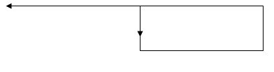
Compare hardware and software interrupt
Hardware interrupt, e.g.
Software interrupt
IRQ_Eint1()
{
::
}
Computer
EINT3
A falling edge at EINT3 will trigger the
execution of the interrupt service routine
irq IRQ_Eint1()
Computer
Main{
:
SWI N
:
}
An instruction “SWI N” in
the program will trigger the
execution of
the N-th-sys-routine
(system routine)
N-th-sys-routine()
{
::
}
SESSION JAN-MAY 2020
4

Slide 5
SOFTWARE METHOD – POLLING
In this method, all interrupts are serviced by branching to the same service program.
This program then checks with each device if it is the one generating the interrupt.
The order of checking is determined by the priority that has to be set.
The device having the highest priority is checked first and then devices are checked in descending order of priority.
If the device is checked to be generating the interrupt, another service program is called which works specifically for that particular device.
The structure will look something like this-
if (device[0].flag) device[0].service();
else if (device[1].flag) device[1].service();
. . . . . .
else //raise error
SESSION JAN-MAY 2020
5
5
Notes:
5

Slide 6
HARDWARE METHOD – DAISY CHAIN
The daisy-chaining method involves connecting all the devices that can request an interrupt in a serial manner.
This configuration is governed by the priority of the devices.
The device with the highest priority is placed first followed by the second highest priority device and so on.
SESSION JAN-MAY 2020
6
6
Notes:
6

Slide 7
Important Interrupts in words
Reset, a special interrupt to start the system– happens at power up , or reset button depressed)
Software interrupt SWI :
Similar to subroutine – happens when “SWI 0x??”
is written in the program
Hardware interrupt
FIQ (fast interrupt) or IRQ (external interrupt), when
the external interrupt request pin is pulled low, or
an analogue to digital conversion is completed, or
A timer/counter has made a regular request
SESSION JAN-MAY 2020
7

Slide 8
Exception (interrupt) Modes
ARM supports 7 types of exceptions and has a privileged processor mode for each type of exception.
ARM Exception (interrupt) vectors
Interrupt Vector Table
SESSION JAN-MAY 2020
8

Slide 9
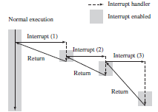
Exception (interrupt) Modes
Nested Interrupt call
Interrupt Service Routine
Status Registers
Saving register contents on to the stack.
Restore while return to the interrupted program.
SESSION JAN-MAY 2020
9

Slide 10
The second method involves prioritization.
You program the interrupt controller to ignore interrupts of the same or lower priority than the interrupt you are handling, so only a higher-priority task can interrupt your handler.
You then re-enable interrupts. The processor spends time in the lower-priority interrupts until a higher-priority interrupt occurs.
Therefore higher-priority interrupts have a lower average interrupt latency than the lower-priority interrupts, which reduces latency by speeding up the completion time on the critical time-sensitive interrupts.
SESSION JAN-MAY 2020
10

Slide 11
IRQ and FIQ Exceptions
IRQ and FIQ exceptions only occur when a specific interrupt mask is cleared in the cpsr
An IRQ or FIQ exception causes the processor hardware to go through a standard procedure (provided the interrupts are not masked):
SESSION JAN-MAY 2020
11

Slide 12
1. The processor changes to a specific interrupt request mode, which reflects the interrupt being raised.
2. The previous mode’s cpsr is saved into the spsr of the new interrupt request mode.
3. The pc is saved in the lr of the new interrupt request mode.
4. Interrupt/s are disabled—either the IRQ or both IRQ and FIQ exceptions are disabled in the cpsr. This immediately stops another interrupt request of the same type being raised.
5. The processor branches to a specific entry in the vector table.
SESSION JAN-MAY 2020
12

Slide 13
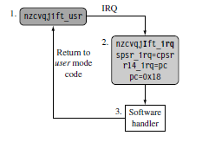
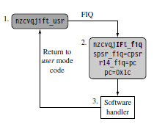
SESSION JAN-MAY 2020
13

Slide 14
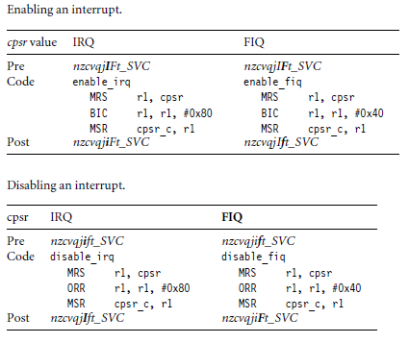
Enabling and Disabling FIQ and IRQ Exceptions
SESSION JAN-MAY 2020
14

Slide 15
Basic Interrupt Stack Design and Implementation
Exceptions handlers make extensive use of stacks, with each mode having a dedicated register containing the stack pointer. The design of the exception stacks depends upon these factors:
■ Operating system requirements—Each operating system has its own requirements for
stack design.
■ Target hardware—The target hardware provides a physical limit to the size and positioning of the stack in memory.
SESSION JAN-MAY 2020
15

Slide 16
Two design decisions need to be made for the stacks:
■ The location determines where in the memory map the stack begins. Most ARM-based systems are designed with a stack that descends downwards, with the top of the stack at a high memory address.
■ Stack size depends upon the type of handler, nested or non nested. A nested interrupt handler requires more memory space since the stack will grow with the number of nested interrupts.
SESSION JAN-MAY 2020
16

Slide 17
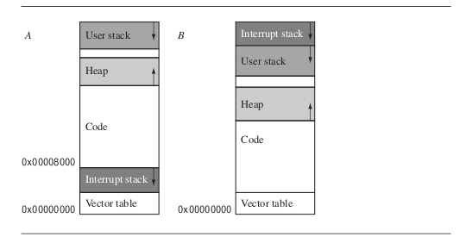
Basic Interrupt Stack Design and Implementation
Stack Layouts
SESSION JAN-MAY 2020
17

Slide 18
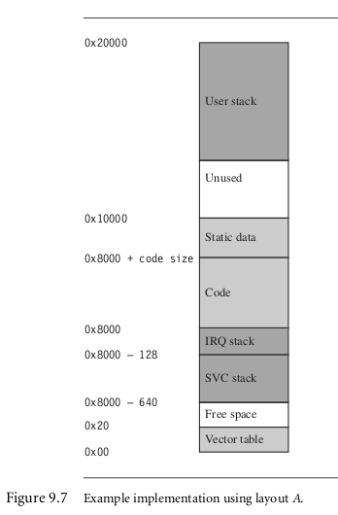
Basic Interrupt Stack Design and Implementation
SESSION JAN-MAY 2020
18

Slide 19
Priority Interrupts
A priority interrupt is a system which decides the priority at which various devices, which generates the interrupt signal at the same time, will be serviced by the CPU.
The system has authority to decide which conditions are allowed to interrupt the CPU, while some other interrupt is being serviced.
Generally, devices with high speed transfer such as magnetic disks are given high priority and slow devices such as keyboards are given low priority.
When two or more devices interrupt the computer simultaneously, the computer services the device with the higher priority first.
SESSION JAN-MAY 2020
19

Slide 20
Programmable Interrupt Controller
8 levels of Interrupts
Can be cascaded in master- slave configuration to handle 64 levels of interrupts.
Internal Priority Resolver
Fixed Priority Mode & Rotating Priority Mode
Individually Maskable Interrupts
Modes and masks can be changed dynamically
Accepts IRQ, determines priority, checks whether incoming priority current level being serviced, issues interrupt signal.
Polled and vectored mode
Starting address of ISR or Vectored number is programmable.
SESSION JAN-MAY 2020
20

Slide 21
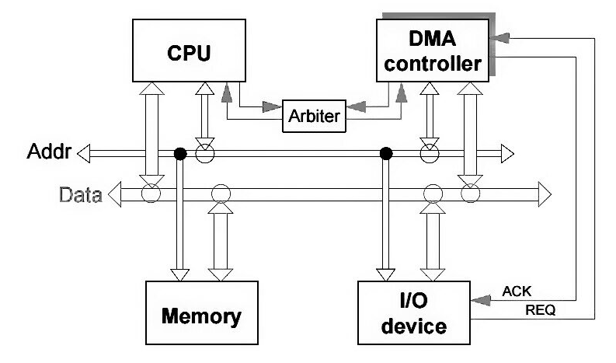
Direct Memory Access(DMA) Controller
What is actually DMA?
The direct memory access is a system where the samples are saved in the memory of the system while the processor does something else.
Why we need DMA?
The assumption about the I/O machines like keyboards, mouse, and printer etc. are genuinely very slow when compared with the central processing unit (CPU).
To overcome this issue an interrupt handler was used and the I/O machine produces all the signals that the CPU produce, then the I/O machine can bypass the information alienates to central processing unit and hence increases the speed.
SESSION JAN-MAY 2020
21

Slide 22
Direct Memory Access(DMA) Controller
Cycle Stealing Process: Traditionally it is a method of accessing RAM or bus without interfering with the CPU.
DMA allows I/O controllers to read or write RAM without CPU intervention.
Clever exploitation of specific CPU or bus timings can permit the CPU to run at full speed without any delay if external devices access memory not actively participating in the CPU's current activity and complete the operations before any possible CPU conflict.
Such systems are nearly dual-port RAM without the expense of high speed RAM.
Most systems halt the CPU during the steal, essentially making it a form of DMA by another name
SESSION JAN-MAY 2020
22

Slide 23
Q & A on Interrupts , Interrupt Handling Mechanism PIC & DMA Controller
SESSION JAN-MAY 2020
23
23
Notes:
23

